Slide 1
NEXT GENERATION OF CHATGPT FOR TRANSFER PRICING PROFESSIONALS
Speakers
Saranya Velayutham – Solution Expert at e-Bright
Umair Ahmed – Solution Expert at e-Bright
November 28, 2024

Slide 2
In House Tax Department Allocation of Time
Source: eBright survey 2024

Slide 3
Why AI for Transfer Pricing?
Dispute Resolution & Specialized Areas (e.g. intangibles)
TP is one of the most research-intensive space in tax
According to a recent survey by the Tax Policy Center, over 50% of tax professionals consider TP as an area requiring most time and effort with respect to research
Comparable Analysis (Financial Databases, Industry Trends & Economic Analysis)
Dynamic & Complex Rules (e.g. OECD BEPS framework)
Complex Documentation Requirements (e.g. CbCR)

Slide 4
Evolution of Search and Research in Transfer Pricing
Non-tech
Current-tech
Generative AI Era
Data Availability and Access
Limited data source, time consuming, data gaps
Access to vast data, filter capability, broader coverage
Continuos real time data gathering, dynamic adjustments,
Inconsistent comparability criteria
Standardized selection criteria
Dynamic adjustments based on AI learning
Standardization
Manual PLI calculations, justification difficulties
Automated PLI calculations
Predictive modeling for future trends
Benchmarking
Manual identification and subjective adjustments
Basic filtering capabilities
Automated outlier detection using AI algorithms
Outlier Detection
Limited predictive capabilities for audits
Risk dashboards for overview
Predictive analytics for proactive compliance
Risk Analysis
Time-consuming manual data extraction
Basic aggregation and report generation
Co-pilot, LLM
Research Insights

Slide 5
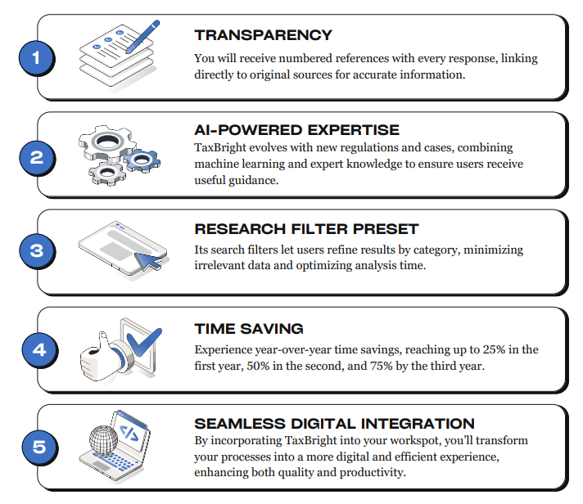
ChatGPT for transfer pricing professionals
Notes:
Quality and version control content. Content sources are shown to you and ready for use for appeals in courts.

Slide 6
THANK YOU
Rivium Quadrant 90, Capelle a/d IJssel, 2909 LC, NL
+31 10 713 8598
welcome@e-bright.com

