Slide 1
Digital transformation for tax professionals

Slide 2
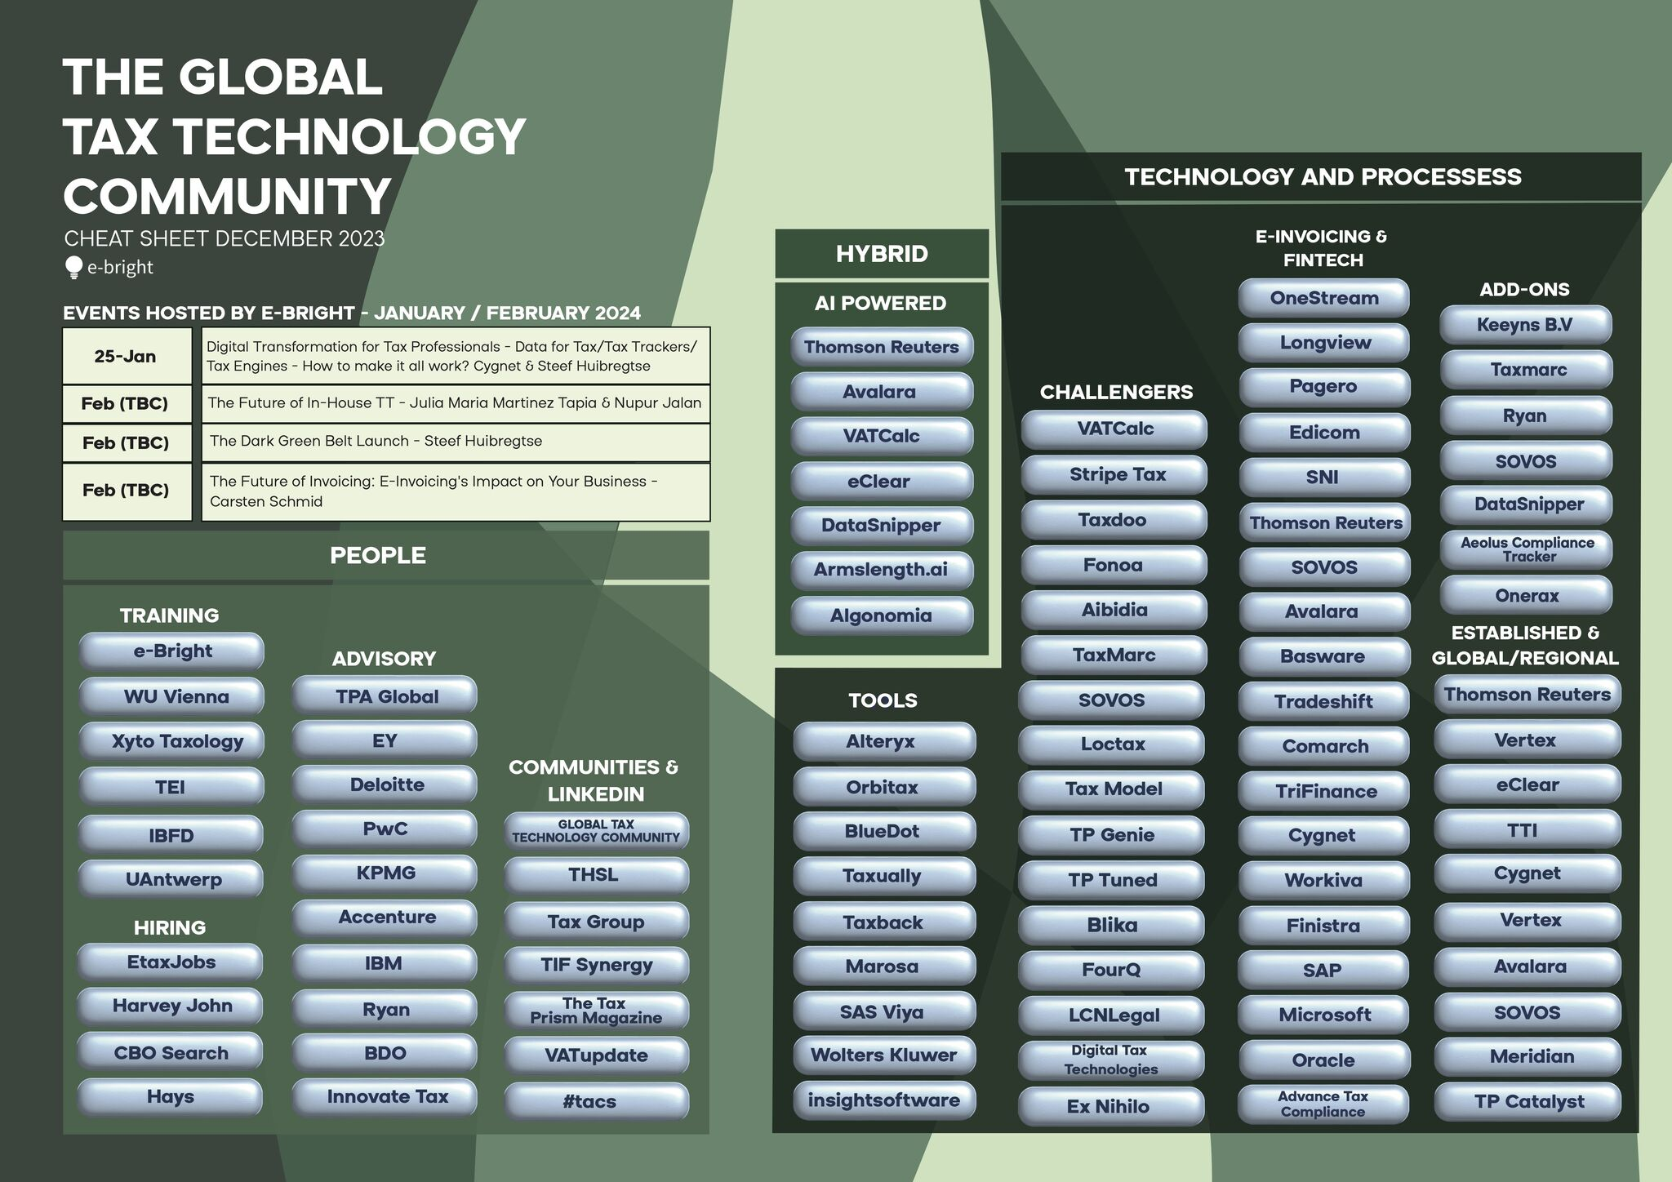
The Global Tax Technology Community
Cygnet
Cygnet

Slide 3
Key Takeaways
Precision in Data Acquisition
Unlock strategies to extract flawless tax data from 25+ business source systems, ensuring CFOs have the right information for strategic decision-making.
Centralization Magic
Delve into the power of centralizing data in a Tax Data Warehouse, unraveling its efficiency for seamless tax management.
Tax Engine Mastery
Navigate tax technology options using the e-Bright cheat sheet, providing CFOs with a comprehensive guide for evaluating and implementing Tax Engines.
Real-Time Strategic Decisions
Empower CFOs with the ability to utilize data analytics for real-time insights, enabling swift and informed decisions in the dynamic tax landscape.
The Belt System Revolution
The Belt System Revolution: Unveil "The Belt System“ A Tax Technology Certification Program for Professionals.

Slide 4
Speakers
Akash Chaudhary
AVP - Integrated Solutions & Presales
Steef Huibregtse
CEO of TPA Global
Akash Chaudhary leads the global Tax Technology portfolio at Cygnet Digital. He has more than a decade’s cross-domain experience in Digital Transformation, Business Process Automation & and large-scale implementations in the Tax Tech space globally.
Steef Huibregtse, a visionary CEO, accomplished author, and renowned expert in digital transformation, stakeholder diversity, and strategic leadership. With a remarkable career spanning from partner roles at top accounting firms to founding TPA Global and e-Bright, Steef has built a legacy of success.

Slide 5
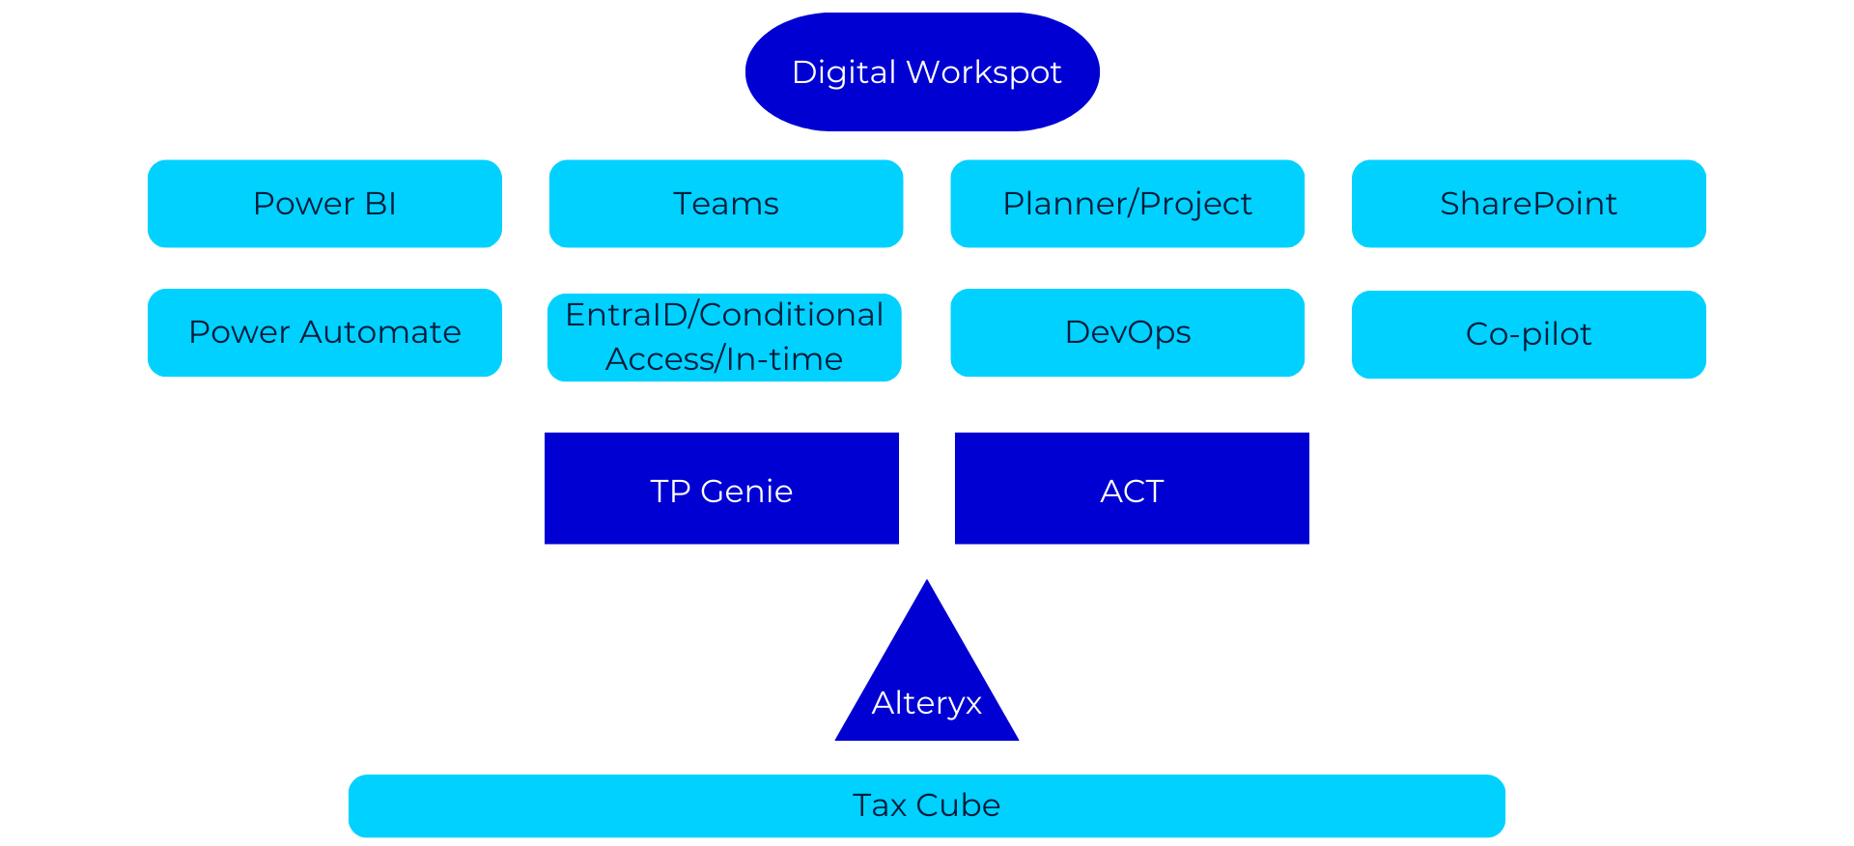
User versus Data Perspective

Slide 6
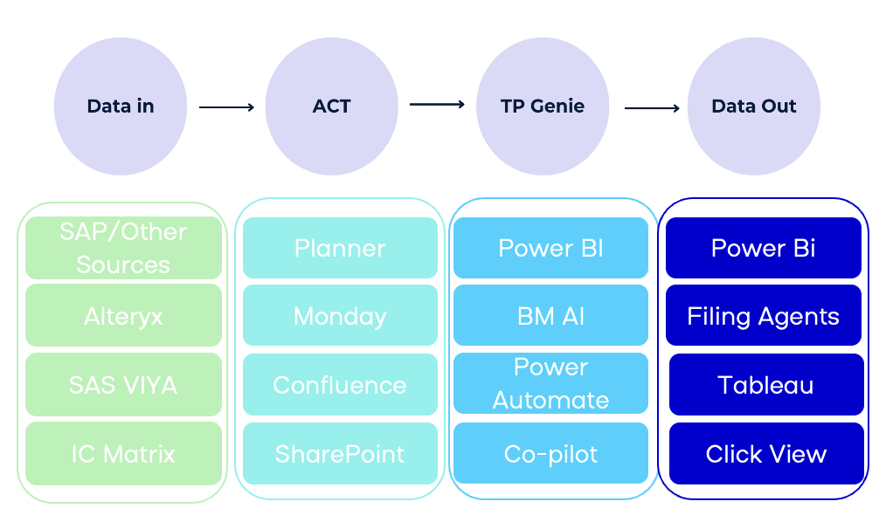
Production flow options to go digital – Ad-hoc approach

Slide 7
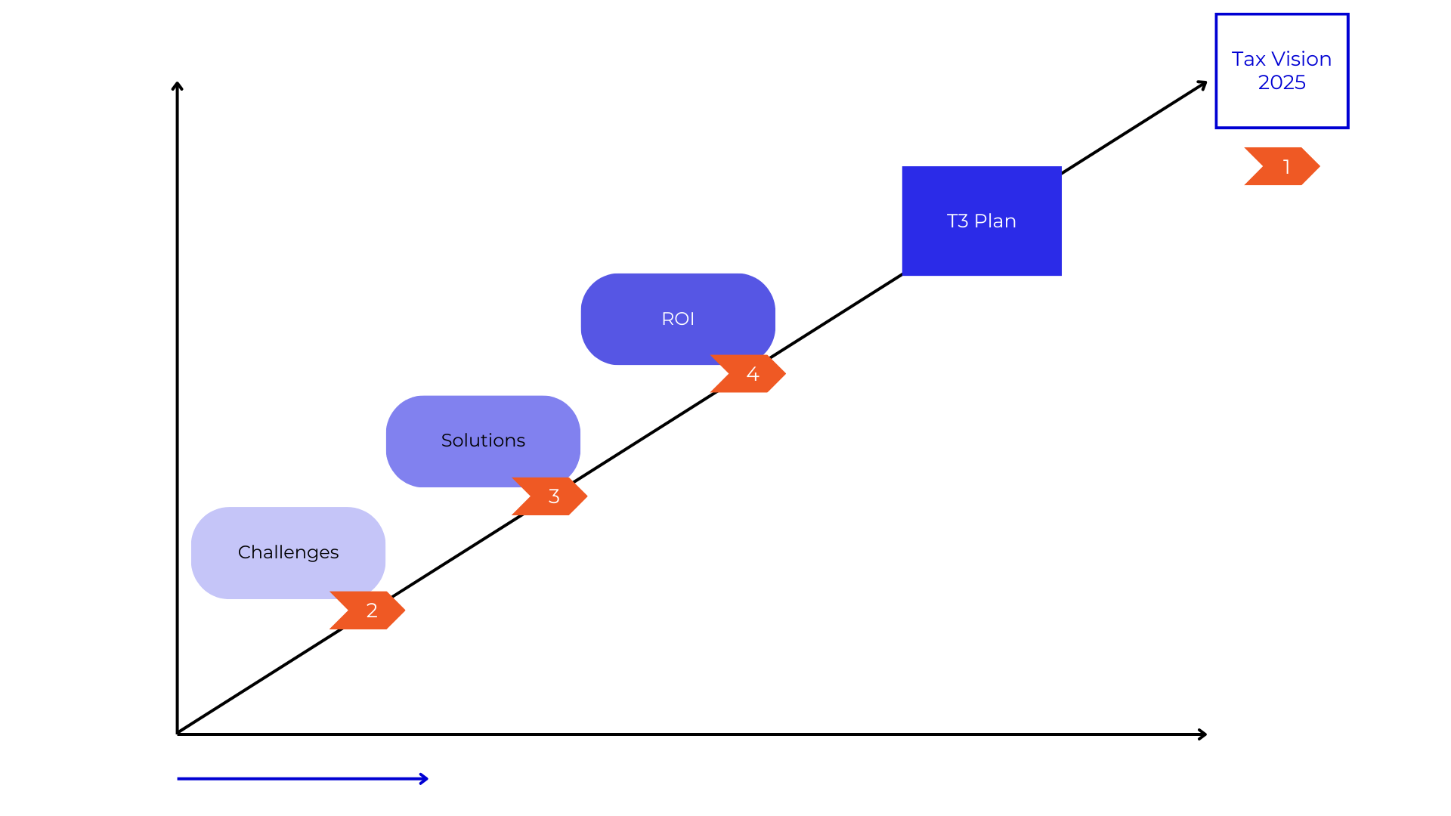
Production flow options to go digital – Structural approach

Slide 8
How myriad of systems cause multiple challenges
Invoice generation tools
No data gets reconciled at a given point since there is no real time sync and integration between systems
Multiple Global and local source systems
More than 60% of the global Corporates haven’t automated the outward process and 80% the inward processes
Increase in overheads, infrastructure maintenance, loading time, TAT time due to calls to multiple systems
Leading to increase in data inconsistencies and errors i.e., (Lack of single source of truth)
Reporting applications
Increased risks of Notices & Litigation due to non-compliance or delay
Global requirements are different, varied and ever evolving
Manual intervention & time and efforts spend
Region specific compliance platforms
Accounting tools

Slide 9
What Marie Kondo does for your house & wardrobe…
Through tidying, you can reset your life and spend the rest of your life surrounded by the people and things that you love the most.
Source: Instagram: mariecondo*
Source: konmari.com*
*images used for reference and education purposes only. no copyright infringement intended.

Slide 10
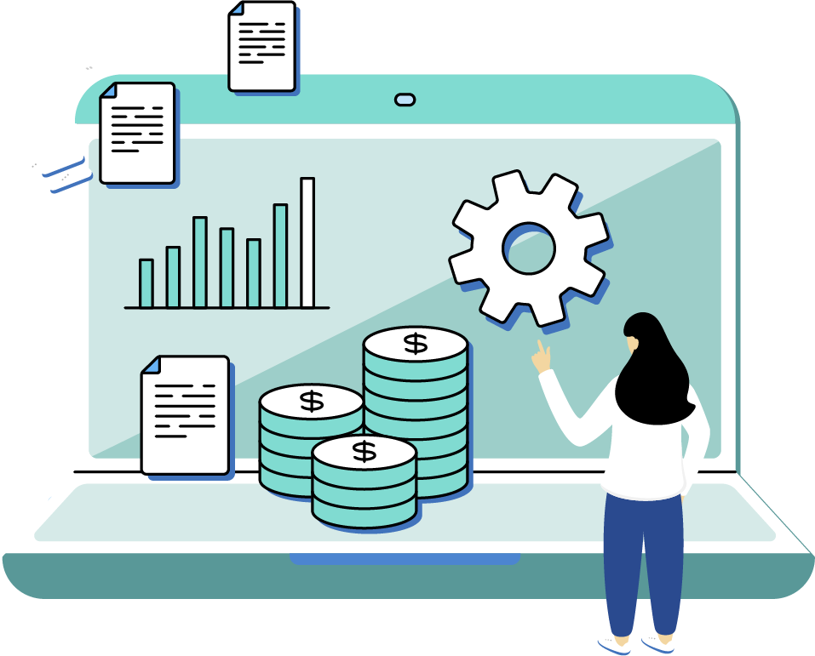
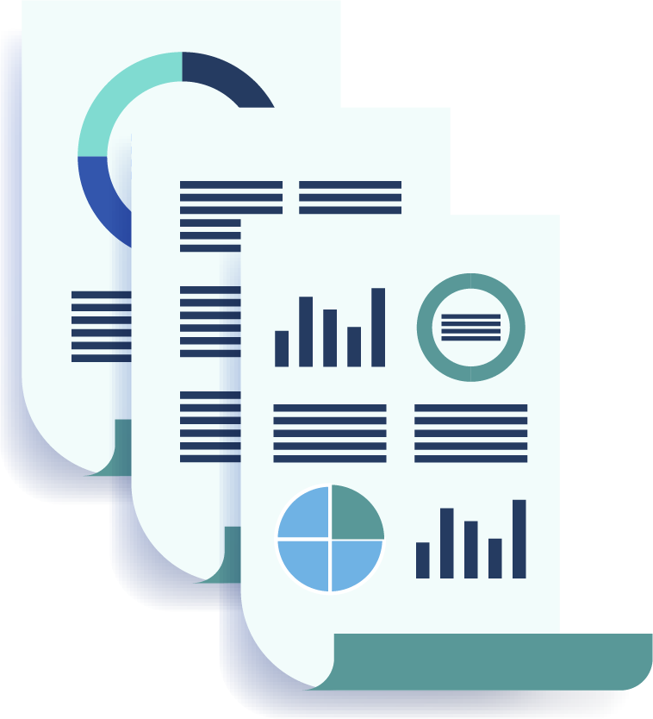
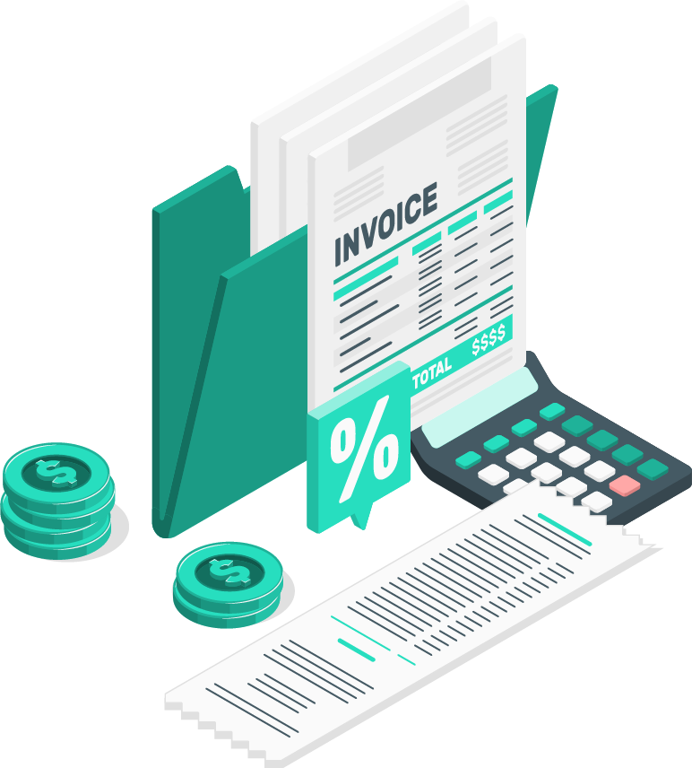
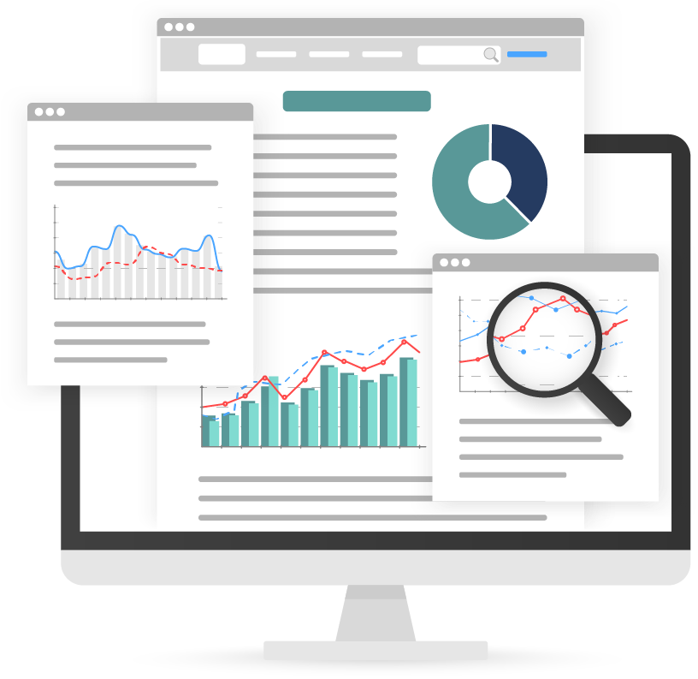
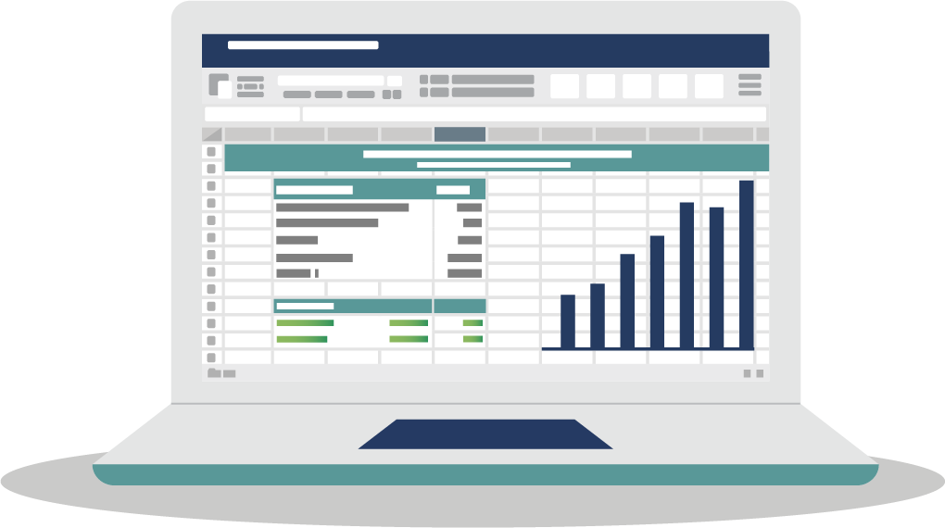
Automation does it for your Finance ecosystem!
Source Systems
Data generation
Reporting systems
GL Recon Systems
E-Comm Marketplace
Report Generation
Global Source System
Internal & External Reporting System
Invoice Generation
Tax/Audit Recording System
Local Compliance & Other Requirements
Excel/Manual Entries

Slide 11
Automation does it for your Finance ecosystem!
A myriad of systems working in synergy
Local apps adapted as per laws of regional authorities
Local adaption for compliance & reporting requirements
Global Source Systems
E-Comm Marketplace
Report Generation
GL Recon Systems
API
BOT
Data management and Processing
Internal & External Reporting System
Global Source System
Invoice Generation
SFTP
Tax/Audit Recording System
Local Compliance & Other Requirements
Excel/Manual Uploads

Slide 12
These systems if structured
Invoice generation tools
Multiple Global and local source systems
Region specific compliance platforms
Accounting tools
Reporting applications

Slide 13
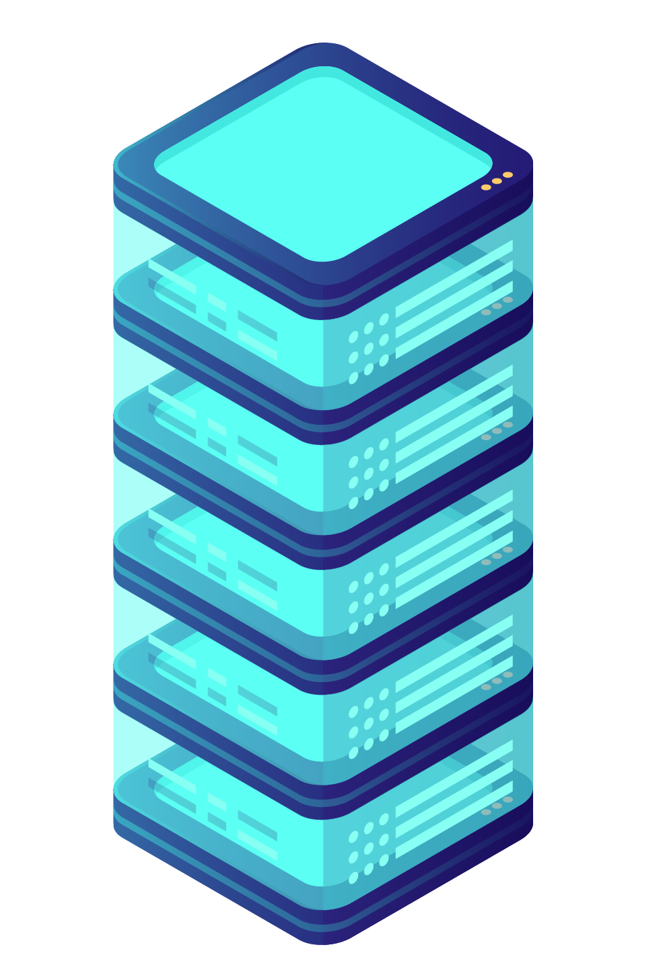
These systems if structured; form an ideal ecosystem
Global Source systems
Data Warehouse
Adapt as per local laws and requirements
Invoice generation tools
Multiple Global and local source systems
Region specific compliance platforms
Accounting tools
Reporting applications

Slide 14
Digitize v/s Transform

Slide 15
Multiple integration options enable a single source of truth for compliance data
HETEROGENEOUS DATA SOURCES
Methods of integration
Compliance automation platform
Data Validation & Errors
Oracle Financial Services
Tax Returns
SAP
Microsoft Dynamic
Reconciliation / GL Recon
Integration
e.g. flat files
PI - PO
API
SFTP
TWZ connector
Govt Regulators
Ready to file formats
Dataproe IBS
DB Connection
Real time Reporting
SSIS
Road Permits
ETL tools
Data convertor
RPA
Tally
Finacle
Audit Reports
JDE
Misys
MANUAL FILES
Cygnet- 85%+ success in integrations – the highest in Industry | In-house SAP team & ERP Partner ecosystem

Slide 16
Digital transformation for inward and outward business process
Invoice digitization Journey
Tax compliance and Invoicing automation
Purchase Invoice automation
Sales Invoice automation
Invoice create /upload
SAP
For data translation, mapping and modeling to address complex broken data from multiple sources
Real time reporting
Vendor 1
Digital or Scanned Invoices, Manual Invoices, API
IDP
Invoice verif.
Oracle
Tax returns
Road Permits
API
Vendor 2
Reco
Approval flow
Reco
A/c payables
Consolidate invoice collection mechanism
Only verified invoices are posted
Microsoft Dynamics
Vendor 3
Real time reporting
Vendor Compliance & Notification mgmt
Govt. Tax regulators
Other ERPs
Notices Mgmt
GL Reco
Vendor Ecosystem
Cygnet Vendor Invoice Post Office
Multiple Source Systems
Cygnet Data Connectors
Cygnet Compliance Platform
Also, Invoicing & Accounting tools for MSME, SME
Purchase Digitization
Payment Automation
E-invoicing
VAT Automation
Reconciliation
Audit Readiness

Slide 17
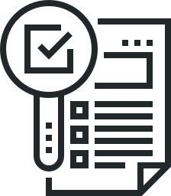
Data Analytics - Taxsurance
Importance of Data Analytics for CFOs and Tax Experts in Financial Services and Taxsurance
Credit Assessment
Accurate credit assessments contribute to a healthier financial ecosystem, potentially reducing the need for tax-related interventions due to economic downturns caused by high default rates.
Risk Evaluation
Mitigating high-risk investments through data analytics contributes to financial stability, reducing the likelihood of tax-related interventions to stabilize the economy during crises.
Fraud Detection
Minimizing financial fraud contributes to a more transparent and accountable financial system, reducing the need for tax adjustments to compensate for losses incurred due to fraud.
Notes:
Conclusion - It enhances decision-making, minimizes risks, and contributes to the overall financial health of institutions, thereby reducing the need for tax-related interventions in response to economic uncertainties.

Slide 18
Benefits of leveraging tax data analytics
Optimizing Tax Planning and Compliance
Identifying Cost Reduction Opportunities
Enhancing Risk Management
Supporting Business Strategy and Decision-making
Enhanced accuracy
Fraud Detection and prevention
Data-driven decision making
Efficient resource allocation
Adaptability to regulatory changes

Slide 19
About Us
Your trusted digital transformation partner in cloud and digital services
Living the Trust of customers across the globe (11 locations)
Founded in
2000
Serving customers in
35+
Countries
1200+
Employees Worldwide
90+
Enterprise Clients Worldwide
Cygnet Operating Locations
Client Locations
750+
Enterprise Solutions
& Products delivered
11
Offices worldwide
Certifications & Compliances

Slide 20
Any Questions?

Slide 22
THANK YOU
NAMASTE

